Slide 1
Unit 6: Inference for Numerical Data
Statistics S-100 Teaching Team
Summer 2024

Slide 2
Introduction
Two-sample test for paired data
Two-sample test for independent group data Statistical power and sample size Comparing several means with ANOVA
A closer look at the p-value

Slide 3
Introduction

Slide 4
Comparing two population means
Two-sample data can be paired or unpaired (independent).
Paired measurements for each ‘participant’ or study unit
each observation can be logically matched to one other observation in the data
e.g., scores on a standardized test before taking a prep course versus scores after the prep course
Two independent sets of measurements
observations cannot be matched on a one-to-one basis
e.g., scores on a standardized test of students who did take a prep course versus scores of students who did not
The nature of the data dictate which two-sample testing procedure is appropriate: the two-sample test for paired data, or the two-sample test for independent group data.

Slide 5
Two-sample test for paired data

Slide 6
wetsuits and swimming velocity
library(oibiostat) data("swim") swim_new <- swim
colnames(swim_new) <- c("id", "ws_vel",
"ss_vel", "vel_diff")
swim_new
Did a new wetsuit design allow for increased swim velocities during the 2000 Olympics?
A study was conducted to assess the effect of wearing a wetsuit on swim velocity.
12 competitive swimmers were asked to swim 1500m at maximal velocity, once wearing a wetsuit and once wearing a standard swimsuit.
Order of wetsuit versus swimsuit randomized.
Investigators recorded mean velocity (m/sec) for each trial.
## id ws_vel ss_vel vel_diff
## 1 | 1 | 1.57 | 1.49 | 0.08
## 2 | 2 | 1.47 | 1.37 | 0.10
## 3 | 3 | 1.42 | 1.35 | 0.07
## 4 | 4 | 1.35 | 1.27 | 0.08
## 5 | 5 | 1.22 | 1.12 | 0.10
## 6 | 6 | 1.75 | 1.64 | 0.11
## 7 | 7 | 1.64 | 1.59 | 0.05
## 8 | 8 | 1.57 | 1.52 | 0.05
## 9 | 9 | 1.56 | 1.50 | 0.06
## 10 10 |  | 1.53 | 1.45 | 0.08
## 11 11 |  | 1.49 | 1.44 | 0.05
## 12 12 |  | 1.51 | 1.41 | 0.10

Slide 7
Idea behind inference for paired data
The velocities are paired by swimmer: each swimmer has two velocity measurements. Suppose that for each swimmer i , we have observations x_{i,WS} and x_{i,SS} .
Let d_{i} be the difference between the measurements:
di = xi,WS − xi,SS
x_{i,WS} is the wetsuit velocity measurement for swimmer i
x_{i,SS} is the swimsuit velocity measurement for swimmer i
Base inference on d , the sample mean of the individual differences d_{i} :
Σ
d
d =
i
n

Slide 8
Inference for paired data
Let δ be the population mean of the difference in velocities during a 1500m swim if all competitive swimmers recorded swim velocities with each suit type.
The null and alternative hypotheses are
H₀ : δ = 0, the average difference in swim velocities between swimming with a wetsuit versus a swimsuit equals 0
i.e., wetsuits do not change swim velocities
H_{A} : δ ̸= 0, the average difference in swim velocities between swimming with a wetsuit versus a swimsuit is non-zero
i.e., wetsuits do change swim velocities
We can also compute a 95% confidence interval for δ.

Slide 9
Inference for paired data . . .
The formula for the test statistic is
d − δ0
t = √ ,
s / n
A 95% confidence interval for paired data has the form
d
where d is the mean of the differences, s is the
 
d
s
standard deviation of the differences, and n is the number of differences (i.e., number of pairs).
⋆ d
d ± t × √ ,
n
⋆
A paired t-test is essentially a one-sample test
where t is the point on a t distribution with
df = n − 1 that has area 0.025 to its right.
of difference values.
The p-value is calculated from a t distribution with df = n − 1.

Slide 10
Letting R do the work
#two-sample syntax
t.test(swim$wet.suit.velocity, swim$swim.suit.velocity, alternative = "two.sided", paired = TRUE)
##
## Paired t-test ##
## data: swim$wet.suit.velocity and swim$swim.suit.velocity
## t = 12.318, df = 11, p-value = 8.885e-08
## alternative hypothesis: true mean difference is not equal to 0 ## 95 percent confidence interval:
## 0.06365244 0.09134756
## sample estimates:
## mean difference ## 0.0775
Note: t.test(x, y, paired = TRUE) returns results based on the differences x - y.

Slide 11
Letting R do the work. . .
#one-sample syntax
t.test(swim$velocity.diff, mu = 0, alternative = "two.sided")
##
## One Sample t-test ##
## data: swim$velocity.diff
## t = 12.318, df = 11, p-value = 8.885e-08
## alternative hypothesis: true mean is not equal to 0 ## 95 percent confidence interval:
## 0.06365244 0.09134756
## sample estimates: ## mean of x
## 0.0775

Slide 12
Two-sample test for independent group data

Slide 13
COVID-19 vaccine acceptance
A study conducted in July 2020¹ investigated factors associated with self-reported willingness to receive a COVID-19 vaccine. Researchers collected data from 1,971 participants via a 15-minute online survey that described 10 hypothetical vaccines.
For example, one hypothetical vaccine was described as being 70% effective, approved and licensed by the US Food and Drug Administration, developed in the United States, and endorsed by Vice President Joe Biden.
A vaccine acceptance score from 1 to 7 was calculated, representing the average response to the question “How likely or unlikely would you be to get Vaccine X?” for the 10 hypothetical vaccines.
A higher score represents greater willingness.
Does mean vaccine acceptance score differ between respondents who described their political ideology as “very liberal” versus “very conservative”?
¹This was before COVID-19 vaccines were available.

Slide 14
COVID-19 vaccine acceptance. . .
Vaccine Acceptance Score versus Political Ideology
very conservative
Political Ideology
very liberal
2
4
Vaccine Acceptance Score
6

Slide 15
Inference for comparing two means
The parameter of interest is µ_{VL} − µ_{VC} , the difference in population mean vaccine acceptance score for those identifying as “very liberal” versus “very conservative”.
The null and alternative hypotheses are
H₀ : µ_{VL} = µ_{VC} , the population mean vaccine acceptance score is the same for those identifying as “very liberal” versus “very conservative”.
H_{A} : µ_{VL} ̸= µ_{VC} , the population mean vaccine acceptance score differs between those identifying as “very liberal” versus “very conservative”.
Equivalently, H₀ : µ_{VL} − µ_{VC} = 0 and H_{A} : µ_{VL} − µ_{VC} ̸= 0.
In general, the hypotheses are written in terms of µ₁ and µ₂.²
The parameter of interest is µ₁ − µ₂.
The point estimate is x ₁ − x ₂.
²The numerical labels are arbitrary, so it is best to explicitly specify which group is considered group 1 versus group 2.

Slide 16
Inference for comparing two means. . .
The t-statistic is:
(x 1 − x 2) − (µ1 − µ2)
t = r
2 2
s s
The 95% confidence interval for the difference in population means has the form
1 2
+
n1 n2
 
r
2 2
s s
The degrees of freedom for the null distribution are different than for the paired data setting.
Use this approximation when doing the test by hand: df = min(n1 − 1, n2 − 1).
⋆
1 ₊ 2
,
(x 1 − x 2) ± t ×
n1 n2
where t⋆ is the point on a t distribution that has area 0.025 to the right, with the same degrees of freedom as used for calculating the p-value of the associated test.
R uses a better approximation called the
Satterthwaite approximation:
2 2
2
(s /n ) + (s /n )
1
1 2
df =
2
2
2
[(s /n ) /(n − 1) + (s /n ) /(n − 1)]
2
2
1
1 1
2
2 2

Slide 17
Letting R do the work
The tilde syntax is used when one vector contains the numerical variable and one vector contains the grouping variable.
#tilde syntax
t.test(vax$likely ~ vax$ideology, mu = 0, paired = FALSE, alternative = "two.sided")
##
## Welch Two Sample t-test ##
## data: vax$likely by vax$ideology
## t = 4.4389, df = 423.85, p-value = 1.154e-05
## alternative hypothesis: true difference in means between group very liberal and group very conser ## 95 percent confidence interval:
## 0.3873987 1.0031275
## sample estimates:
## mean in group very liberal mean in group very conservative ## 5.267829 4.572566

Slide 18
Letting R do the work. . .
The comma syntax is used when there are two vectors of numerical data.
#comma syntax
t.test(vax$likely[vax$ideology == "very liberal"], vax$likely[vax$ideology == "very conservative"])
##
## Welch Two Sample t-test ##
## data: vax$likely[vax$ideology == "very liberal"] and vax$likely[vax$ideology == "very conservati
## t = 4.4389, df = 423.85, p-value = 1.154e-05
## alternative hypothesis: true difference in means is not equal to 0 ## 95 percent confidence interval:
## 0.3873987 1.0031275
## sample estimates: ## mean of x mean of y ## 5.267829 4.572566

Slide 19
Statistical power and sample size

Slide 20
Outcomes and errors in testing
In a trial, the defendant is either innocent or guilty. After hearing evidence from both the prosecution and the defense, the court must reach a verdict.
Hypothesis tests can potentially result in incorrect decisions. The following table shows the four possible ways that the conclusion of a hypothesis test can be right or wrong.
Under many legal systems, presumption of innocence is a legal right of the accused.
H0: The defendant is innocent.
HA: The defendant is guilty.
What does a Type I error represent in this context?
What does a Type II error represent in this context?
 | Result of test
State of nature | Reject H0 | Fail to reject H0
H0 is true | Type I error, probability = α (false positive) | No error, probability = 1 − α (true negative)
HA is true | No error, probability = 1 − β (true positive) | Type II error, probability = β (false negative)

Slide 21
Error probabilities in hypothesis testing
Lab 2 uses simulation to explore how Type I and Type II error are controlled.
Type I error is controlled via rejecting H₀ only when a p-value is smaller than α.
Statisticians are most often concerned with the complement of making a Type II error.
The power of a statistical test is the probability that the test will reject the null hypothesis when the alternative hypothesis is true.
In other words, power is the probability of correctly rejecting H₀.

Slide 22
Factors affecting power
The power of a statistical test is determined by³
the hypothesized difference between two population means, also known as the population
effect size (♣µ₁ − µ₂♣)
the population standard deviation of each group (σ₁, σ₂)
the sample size of each group (n₁, n₂)
Think about power as a measure of how easy it is to distinguish whether two groups have different (population) means.
Usually, a study team can only control sample size.
³The significance level α also influences power. More on this in Lab 2...

Slide 23
Example: Treatment for Alzheimer’s
Treatment for Alzheimer’s disease is an active research area. The Dementia Severity Rating Scale (DSRS) measures impairment severity of a person with Alzheimer’s. Scores range from 0 (indicating no impairment) to 54 (extreme impairment).
Cognitive decline over several years is measured by annual rate in change in DSRS score.
Example: a person observed for 3 consecutive years whose score increased from 7 to 14.5 has an annual rate of change of 7.5/3 = 2.5 points per year.
Suppose a pharmaceutical company developed a drug to slow cognitive decline in individuals affected by Alzheimer’s disease.
Conduct a randomized trial, comparing standard drug to new drug.
Enroll newly diagnosed patients, measure DSRS at beginning of study and 3 years later.
Compare average annual change in DSRS score between the two groups.
Test H₀ : µ_{ctrl} = µ_{trt} against H_{A} : µ_{ctrl} ̸= µ_{trt} .

Slide 24
Intuition behind power
Suppose HA is true and that we know the
population distribution of DSRS score among the control group and treatment group:
Control: µctrl = 3.5 pts/yr
Treatment: µtrt = 2.5 pts/yr
Approx. Sampling Distributions of Xtrt ^{and X}ctrl ^{under H}A
100
What would the sampling distributions of X trt
count
and X ctrl look like?
50
If we only get to observe one random sample
from each group, how likely would we be to conclude that the population means are different?
o i.e., How likely would we be to reject H0
correctly?
0
2
3
statistic
4
group
treatment control

Slide 25
Intuition behind power: effect size
Effect size (|µ1 − µ2|) refers to the
Effect Size of 1 Unit
hypothesized difference between two population means.
200
count
100
On the previous slide, we supposed that µctrl
0
= 3.5 pts/yr and µtrt = 2.5 pts/yr, which corresponds to effect size
0
2
statistic
4
Effect Size of 2 Units
∆ = |µctrl − µtrt | = |3.5 − 2.5| = 1 pt/yr.
200
What if the effect size were larger; i.e., if the
count
new drug were actually more effective?
What if µtrt = 1.5 pts/yr, ∆ = 2 pts/yr?
What if µtrt = 0.5 pts/yr, ∆ = 3 pts/yr?
100
0
0
2
statistic
4
Effect Size of 3 Units
As effect size increases, does power increase or
decrease?
o As effect size increases, does it become easier or harder to detect a difference in population means?
200
count
100
0
0
2
statistic
4

Slide 26
Intuition behind power: sample size
Sample Size n = 50 (Per Group)
80
How does sample size affect power?
60
count
40
20
Hint: recall that the standard error of X
depends on n.
0
0
2
statistic
4
6
Let’s run some simulations with different
sample size.
o What if n = n = 50?
Sample Size n = 100 (Per Group)
120
trt ctrl
90
count
60
What if ntrt = nctrl = 100?
What if ntrt = nctrl = 300?
30
0
0
2
statistic
4
6
As sample size increases, does power increase
or decrease?
o As sample size increases, does it become easier or harder to detect a difference in population means?
Sample Size n = 300 (Per Group)
200
150
count
100
50
0
0
2
statistic
4
6

Slide 27
Intuition behind power: standard deviation
Standard Deviation of 4 Units
How does standard deviation (σtrt, σctrl )
300
affect power?
count
200
100
Hint: recall that the standard error of X
depends on σ.
0
0
1
2
statistic
3
4
5
Let’s run some simulations with different
Standard Deviation of 6 Units
standard deviation of DSRS score.
What if σtrt = σctrl = 4?
What if σtrt = σctrl = 6?
What if σtrt = σctrl = 10?
200
150
100
50
0
count
0
1
2 3
statistic
4
5
As standard deviation increases, does power
Standard Deviation of 10 Units
increase or decrease?
o As standard deviation increases, does it become easier or harder to detect a difference in population means?
100
count
50
0
0
1
2
statistic
3
4
5

Slide 28
Background for power simulation lab. . .
Part I: Controlling Type I error
Assume that H₀ : µ_{ctrl} = µ_{trt} is true.
Draw repeated samples from simulated control and treatment populations.
Conduct a hypothesis test for each set of two samples.
How many samples resulted in the correct decision?
Part II: Controlling Type II error
Assume that H_{A} : µ_{ctrl} ̸= µ_{trt} is true.
Draw repeated samples from simulated control and treatment populations.
Conduct a hypothesis test for each set of two samples.
How many samples resulted in the correct decision?
o How does this number change when we change the sample size? . . . the standard deviation? . . . the effect size?

Slide 29
Choosing the right sample size
Study design often includes calculating a sample size such that the probability of rejecting a null hypothesis correctly is acceptably large, typically between 0.80 and 0.90.
It is important to have a precise estimate of an appropriate study size.
A study needs to be large enough to allow for sufficient power to detect a difference between groups.
However, unnecessarily large studies are expensive, and can even be unethical.

Slide 30
A typical sample size question
A pharmaceutical company has developed a new drug to lower blood pressure and is planning a clinical trial to test its effectiveness.
Individuals whose systolic blood pressure is between 140 and 180 mmHg will be recruited.
Based on previous studies, blood pressures from such individuals will be approximately normally distributed with standard deviation of about 12 mmHg.
Participants will be randomly assigned to the new drug or a standard drug, and the company will measure the difference in mean blood pressure levels between the groups.
The company expects to receive FDA approval for the drug if there is evidence that the drug lowers blood pressure, on average, by at least 3 mmHg more than the standard drug.
How large should the study be if the company wants the power of the study to be 0.80 (80%)?

Slide 31
A typical sample size question . . .
We will use the power.t.test() function for power and sample size calculations.⁴
To achieve a power of at least 0.80, the company should recruit at least 253 patients for each group; i.e., a total of at least 506 patients.
power.t.test(n = NULL, delta = 3, sd = 12, sig.level = 0.05, power = 0.80)
## ## ## ## ## ## ## ## ## ##
Two-sample t test power calculation
n = 252.1281
delta = 3
sd = 12
sig.level = 0.05
power = 0.8 alternative = two.sided
## NOTE: n is number in *each* group
⁴OI Biostat Section 5.4 has an extended discussion of this example, with formulas for hand calculations.

Slide 32
Comparing several means with ANOVA

Slide 33
Type I error rate for a single test
Suppose we are interested in comparing means across more than two groups. Why not conduct several two-sample t-tests?
•
If there are k groups, then =
k k(k−1)
t-tests are needed.
2 2
Conducting multiple tests on the same data increases the overall rate of Type I error.
Recall that making a Type I error (rejecting H₀ when H₀ is true) occurs with probability α.
Type I error rate is controlled by rejecting only when a test p-value is smaller than α.
α is typically kept low.
With a single two-group comparison at α = 0.05, there is a 5% chance of incorrectly identifying an association where none actually exists.

Slide 34
What about several tests?
What happens to Type I error when making several comparisons? When conducting more than one t-test in an analysis. . .
The significance level (α) used in each test controls the error rate for that test.
The experiment-wise error rate is the chance that at least one test will incorrectly reject
H₀ when all tested null hypotheses are true.
Controlling experiment-wise error rate is one specific approach for controlling Type I error.

Slide 35
Probability of experiment-wise error
Suppose that two t-tests are conducted to assess whether two new drug candidates are associated with better outcome. Assume the tests are independent and each are conducted at the α = 0.05 significance level.
Let A be the event of making a Type I error on the first test, and B be the event of making a Type I error on the second test, where P(A) = P(B) = 0.05.
The probability of making at least one error is equal to the complement of the event that a Type I error is not made with either test.
1 − [P(A^{C} )P(B^{C} )] = 1 − (1 − 0.05)² = 0.0975
Thus, when making two independent t-tests, there is about a 10% chance of making at least one Type I error; the experiment-wise error is 10%.

Slide 36
Probability of experiment-wise error. . .
With 10 tests. . .
experiment-wise error = 1 − (1 − 0.05)¹⁰ = 0.401
With 25 tests. . .
experiment-wise error = 1 − (1 − 0.05)²⁵ = 0.723
With 100 tests. . .
experiment-wise error = 1 − (1 − 0.05)¹⁰⁰ = 0.994
With 100 independent tests, there is a 99.4% chance an investigator will make at least one Type I error!
If a company tested 100 drug candidates (that actually aren’t effective), there is a 99.4% chance of incorrectly concluding that at least one candidate is effective.

Slide 37
Analysis of Variance (ANOVA)
ANOVA uses a single hypothesis test to assess whether means across several groups are equal:
H₀: mean outcome is same across all groups (µ₁ = µ₂ = µ₃ = ... = µ_{k} )
H_{A}: at least one mean is different from the others (i.e., means are not all equal)
By using a single test, the Type I error rate is still maintained at α.

Slide 38
Idea behind ANOVA
Are the sample means different enough that H₀ seems unlikely to be true?
i.e. Does it seem like the sample means come from different populations, or could it be plausible that they are simply different samples drawn from one population?
Compare two quantities:
Variability between groups (MSG ): how different are the group means from each other, i.e., how much does each group mean vary from the overall mean?
Variability within groups (MSE ): how variable are the data within each group?
MSG denotes mean square between groups, while MSE denotes mean square error. Refer to OI Biostat
Section 5.5.1 for details.

Slide 39
Idea behind ANOVA. . .
4
3
2
1
0
−1
outcome
I
II
III
IV
V
VI
I, II, and III: difficult to discern differences in means, variability within each group is high
IV, V, and VI: appears to be differences in means, these differences are large relative to variance within each group

Slide 40
Idea behind ANOVA. . .
Under the null hypothesis, there is no real difference between the groups; thus, any observed variation in group means is due to chance.
Think of all observations as belonging to a single group.
Variability between group means should equal variability within groups.
The F-statistic is the test statistic for ANOVA.
_{F =} variance between groups ₌ MSG
variance within groups MSE
If the F -statistic is approximately 1, this suggests that the null hypothesis is true.
If the F -statistic is (much) larger than 1, this suggests that the population means are different.
The F -statistic follows an F distribution, with two degrees of freedom, df1 and df2;
df1 = ngroups − 1, df2 = nobs − ngroups .
The p-value for ANOVA equals P(F ≥ F -stat).

Slide 41
Assumptions for ANOVA
Important to check whether the assumptions for conducting ANOVA are reasonably satisfied:
Observations are independent within and across groups.
Think about study design/context.
Data within each group are approximately normal.
Look at the data graphically, such as with a histogram.
Normal Q-Q plots can help. . .
Variability across groups is about equal.
Look at the data graphically.
Numerical rule of thumb: ratio of largest variance to smallest variance < 3 is considered “about equal”.

Slide 42


Normal probability plots (Q-Q plots)
−3 −2 −1 0 1 2 3 −3 −2 −1 0 1 2 3 −3 −2 −1 0 1 2 3
●
●
2
1
● ●
3
2
1
0
−1
−2
−3
●
1
●● ●
●●
●●
●●
●
●
●
●●
●●●●
●
●●●●●
●●
●●
●●●●
●●
●●●
●●●
●●
●●
●●●
●
●●
●●
observed
observed
0
−1
−2
observed
●●
●●●●
●●
0
●
●●●●●
●●●
●●●
●
●●●
●
●●●●●
●
●●●
●●
●
●
●●
●●●
●
●●●●
●●
●●
●●●●●
●●●
●●
●
●●
●
●
●●
●●●
●●●
−1
●
●
●
●●
●●
●
●●
●●
●●●●
●
●●●●●
●●●
●●
● ●
●●●●
●●
●●●
−2
●
●
●
●
●●
●
●●●
●
●
−2 −1 0 1 2
Theoretical Quantiles
●
−2 −1 0 1 2
Theoretical Quantiles
●
●●
−3 −1 0 1 2 3
Theoretical Quantiles
If points fall on or near the line, data closely follow a normal distribution.
Difficult to evaluate in small datasets.
Plots show three simulated normal datasets: from L to R, n = 40, n = 100, n = 400

Slide 43
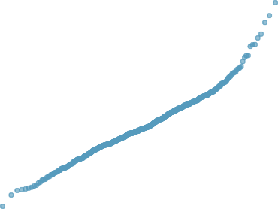
Normal probability plots (Q-Q plots). . .
Histogram of Simulated Right−Skewed Data Normal Q−Q Plot
75
20
Sample Quantiles
count
50
10
25
0
0
10
20
−2
0
Theoretical Quantiles
2
sim.data

Slide 44
Pairwise comparisons
If the F -test indicates there is sufficient evidence that the group means are not all equal, proceed with pairwise comparisons to identify which group means are different.
Pairwise comparisons are made using the two-sample t-test for independent groups.
To maintain the overall Type I error rate at α, each pairwise comparison is conducted at at an adjusted significance level referred to as α⋆.
The Bonferroni correction is one method for adjusting α.
α⋆ = α/K, where K = ^{k(k − 1)} for k groups
2
Note that the Bonferroni correction is a very stringent (i.e., conservative) correction, made under the assumption that all tests are independent.

Slide 45
COVID-19 vaccine acceptance, again
Vaccine Acceptance Score versus Political Party
6
With ANOVA, we can address a different version of the question addressed in the two-group context.
Vaccine Acceptance Score
Does mean vaccine acceptance score differ by
4
political party?
Respondents reported political party as either
Republican, Democrat, or Independent.
2
republican
democrat
Political Party
independent

Slide 46
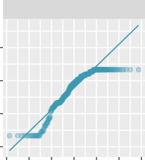
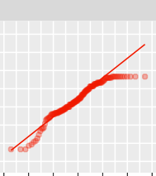
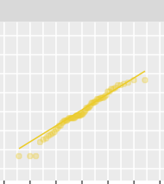
COVID-19 vaccine acceptance, again. . .
Check assumptions:
republican
democrat
independent
Independence. Data are from participants taking an online survey, so it is reasonable to consider the responses as independent
Approximate normality. Q-Q plots indicate some departures from normality for the extreme values, but observations mostly follow normality in the centers
Approximately constant variance. ratio of largest to smallest variance is 1.65, which is considered “about equal”
Sample Quantiles
9
6
3
0
−3 −2 −1 0 1 2 3 −3 −2 −1 0 1 2 3 −3 −2 −1 0 1 2 3
Theoretical Quantiles
#check variance
tapply(vax$likely, vax$party3, var)
## republican democrat independent ## 3.439048 2.163715 2.083126
3.44/2.08
## [1] 1.653846

Slide 47
COVID-19 vaccine acceptance, again. . .
summary(aov(vax$likely ~ vax$party3))
State hypotheses.
##
## vax$party3 ## Residuals ## ---
Df Sum Sq Mean Sq F value Pr(>F)
H0 : µI = µD = µR , mean
2 23.7 11.864 4.188 0.0158 *
vaccine acceptance score is equal across political party.
459 1300.4 2.833
## Signif. codes: 0 '***' 0.001 '**' 0.01 '*' 0.05 '.' 0.1 ' ' 1
The p-value from the ANOVA F -test is 0.0158.
HA: at least one group has a
mean vaccine acceptance score different from that of the other groups.
If the population mean vaccine acceptance scores were
actually the same across groups, the probability of observing an F -statistic as large as 4.19 or larger equals 0.0158.
Let α = 0.05.
These data suggest that at least one population mean vaccine
acceptance score is different from the others.

Slide 48
Controlling Type I error rate
If the ANOVA F -test is significant, then it is appropriate to proceed to conducting pairwise comparisons; i.e., using two-sample t-tests to compare each possible pairing of the groups.⁵
Each test should be conducted at the α⋆ significance level so that the overall Type I error rate remains at α.
These tests are still conducted under the assumption that the variance between groups is equal; thus, the test statistics are calculated using the pooled estimate of standard deviation between groups. Details are in OI Biostat Section 5.5.3.
We will use pairwise.t.test( ) to perform these post hoc two-sample t-tests.
⁵These t-tests are typically referred to as post hoc tests.

Slide 49
Post hoc testing
Each test should be conducted at the α⋆ = 0.05/3 = 0.0167 significance level since there are 3 comparisons being made.
There is evidence that Independents are different from both Republicans and Democrats.
There is not evidence that Republicans and Democrats are different.
pairwise.t.test(vax$likely, vax$party3, p.adj = "none")
##
## Pairwise comparisons using t tests with pooled SD ##
## data: vax$likely and vax$party3
##
## republican democrat ## democrat 0.7424 -
## independent 0.0046 0.0149
##
## P value adjustment method: none

Slide 50
Letting R do the work. . .
Setting p.adj to "bonf" instructs R to rescale the p-values (by multiplying by K , the total number of comparisons) so they can be compared to the original α level of 0.05.
pairwise.t.test(vax$likely, vax$party3, p.adj = "bonf")
##
## Pairwise comparisons using t tests with pooled SD ##
## data: vax$likely and vax$party3
##
## republican democrat ## democrat 1.000 -
## independent 0.014 0.045
##
## P value adjustment method: bonferroni

Slide 51
A closer look at the p-value

Slide 52
Fisher’s p-value
In 1925, Ronald Fisher published Statistical Methods for Research Workers, a book aimed at providing biologists with the means of applying statistical tests accurately to numerical data.
“The value for which P = 0.05, or 1 in 20, is 1.96 or nearly 2; it is convenient to take this point as a limit in judging whether a deviation is to be considered significant or not. Deviations exceeding twice the standard deviation are thus formally regarded as significant. . . ”
Provided a valuable rule of thumb at a time when the use of tables and approximations were essential for practicing researchers
Over time, the p-value in conjunction with the hypothesis testing framework developed by Jerzy Neyman and Egon Pearson became widely used across many scientific disciplines.

Slide 53
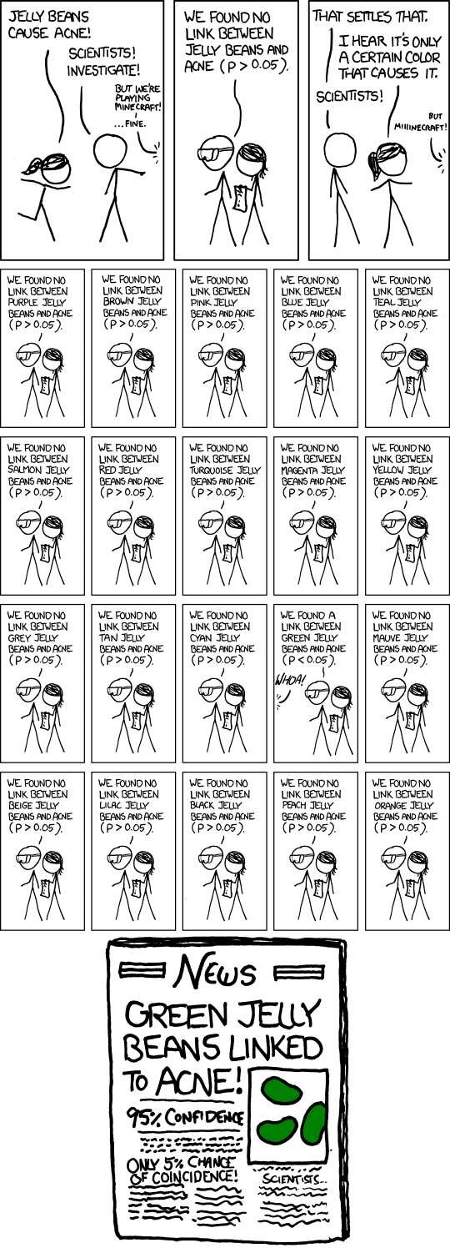
The mis-use of p-values
“P-hacking” refers to the conscious or unconscious manipulation of data in order to achieve a desired result (i.e., a significant p-value):
There are many possible decisions in the data analysis process, and no obviously correct way to proceed.
Unconscious bias can lead researchers to make decisions that will
confirm what they would like to believe.
Non-significant results are difficult to publish in scientific journals.
Tempting to perform many hypothesis tests and only report the
statistically significant results.
The following slide shows an interactive “data analysis” from "Science isn’t Broken".ª
ªFiveThirtyEight, 19 Aug 2015.

Slide 54
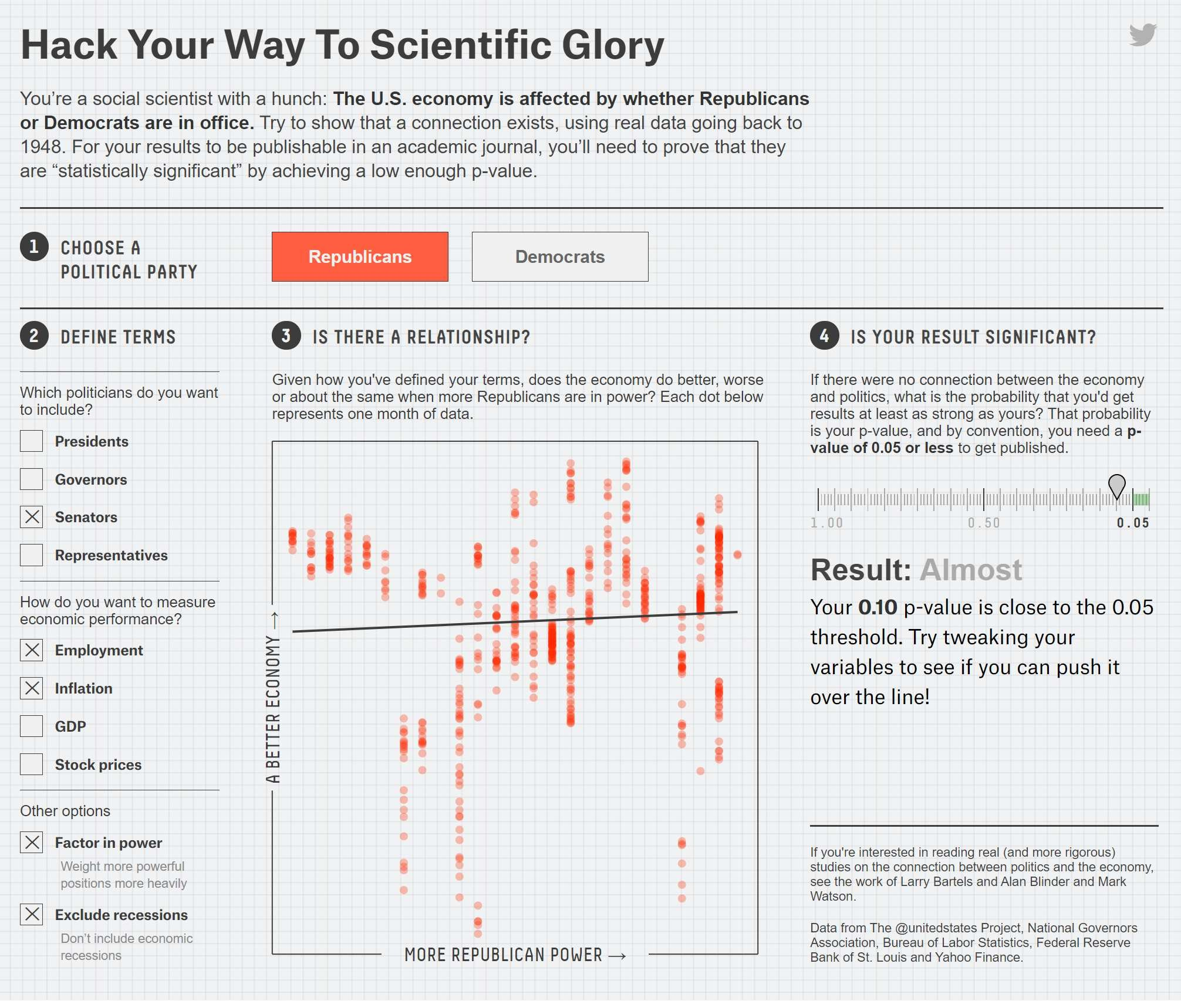
The mis-use of p-values. . .

Slide 55
Statistical significance versus practical significance
In 2016, the American Statistical Association released a formal statement clarifying principles about the proper use and interpretation of the p-value. Some main points mentioned:
A p-value does not measure the size of an effect or the importance of a result. Statistical significance is not equivalent to scientific, human, or economic significance.
Scientific conclusions and business or policy decisions should not be based only on whether a p-value passes a specific threshold. Many other contextual factors should be considered, such as the design of a study, the external evidence for the phenomenon under study, and the validity of the assumptions that underlie the data analysis.
A 2013 study published in PNAS of 19,000+ people found that people who meet their spouses online. . .
Are less likely to divorce than those who meet offline (p < 0.002)
Are more likely to have higher marital satisfaction
Important to examine the effect sizes:
Divorce rate of 5.96% for those who met online versus 7.67% for those who met in person.
On a 7 point scale, happiness value of 5.64 for those who met online versus 5.48 for those who met offline.
Do these results provide compelling evidence that one should change their behavior?ª
ªStudy results reported in a Scientific American article: "Meeting Your Spouse Online May Lead to a Better Marriage".
(p < 0.001)

Slide 56
Modern solutions
Emphasizing reproducibility and replicability.
Making data and analysis code public.
Publishing negative/inconclusive results.
Reporting analysis plan before conducting experiments.
e.g., a two-stage peer review process in which methods and proposed analyses are peer-reviewed prior to data collection and analysis
Focusing interpretation of data on effect sizes and confidence intervals.
Asking “How much of an effect is there?” versus “Is there an effect?” Moving to a World Beyond "p < 0.05"
Editorial accompanying a special issue of The American Statistician from Mar 2019, containing 43 papers discussing how to move to “a world where researchers are free to treat ‘p = 0.051’ and ‘p = 0.049’ as not being categorically different.”

Slide 57
What should you keep in mind?
When conducting research. . .
Clearly specify details of an analysis approach (e.g., primary outcome, significance level, number of tests) before viewing data.
Understand how to appropriately use and interpret p-values.
Report interval estimates, not just p-values.
When possible, replicate an analysis with new data.
When consuming research. . .
Be wary of strong conclusions based solely on a p-value.
Consider factors such as study design, measurement quality, validity of any assumptions made, and plausibility (e.g., evidence for a biological mechanism).
Avoid confusing statistical significance with practical significance.

